Slide 1
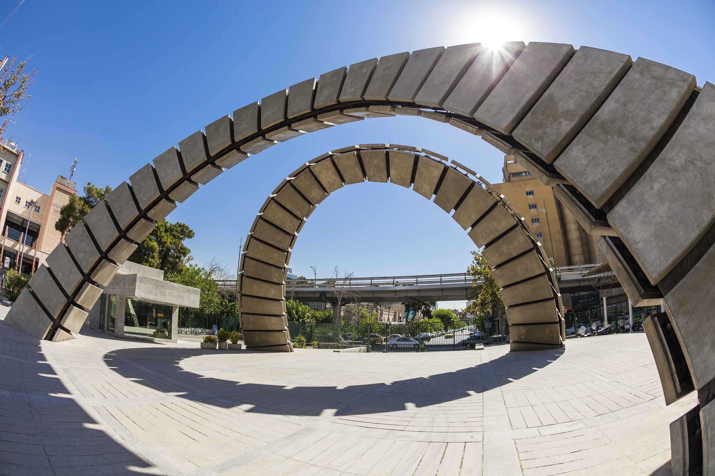

Amirkabir University of Technology
Department of Foreign Languages

Slide 2

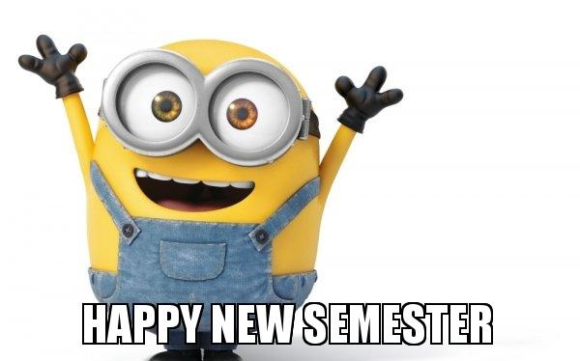
Dear great students,
Happy New Semester!
Welcome to a new start!

Slide 3

Amirkabir University of Technology
Department of Foreign Languages
Course: General English (1)
Semester: Winter, 2021
Instructor: Fatemeh Asadnia
Email Address: asadnia.fatemeh@yahoo.com

Slide 4

Course objectives:
To reinforce students’ reading comprehension strategies
To build students’ semi/technical vocabulary and grammar knowledge base in context
To develop students’ basic understanding of writing

Slide 5

Classroom Rules:
Participation (synchronous classes)
Weekly assignments (asynchronous activities)
Assessment
General English (1)

Slide 6

Weekly Schedule:

Slide 7
Chapter | Reading passage | Reading strategy | Grammar | Writing | Semi/technical words
1 | The Origin of the Universe | Using headings + Skimming | Nouns | Basic features of a paragraph | Word list
2 | Internet of Things (IoT) | Making inferences | Future tense | Coherent paragraph | Word list
3 | Gamification | Guess the meaning of words(1) | Adverbs | Descriptive paragraph | Word list
4 | Space exploration | Scanning | Adjectives | Concluding paragraph | Word list
5 | Crisis Management | Guess the meaning of words(2) | Indirect speech | Expository paragraph | Word list
6 | STEM | Guess the meaning of words(3) | Parallel construction | Narrative paragraph | Word list

Slide 8


